Slide 1

Chapter 13
Managing Conflict in Relationships

Slide 2
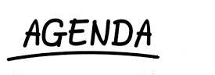
Interpersonal Conflict Definition
Principles of Conflict
Orientation to Conflict
Responses to Conflict
Communication Patterns
Effective Communication During Conflict

Slide 3
Defining Interpersonal Conflict
Interpersonal conflict exists when people who depend on each other express different views, interests, or goals that they perceive as incompatible or opposite.

Slide 4

Defining Interpersonal Conflict (cont’d)
Expressed Disagreement
Interdependence
The Felt Need for Resolution

Slide 5
Principles of Conflict
Conflict Is Natural in Relationships
Conflict May Be Overt or Covert
Social Groups Shape the Meaning of Conflict Behaviours
Conflict Can Be Managed Well or Poorly
Conflict Can Be Good for Individuals and Relationships

Slide 6
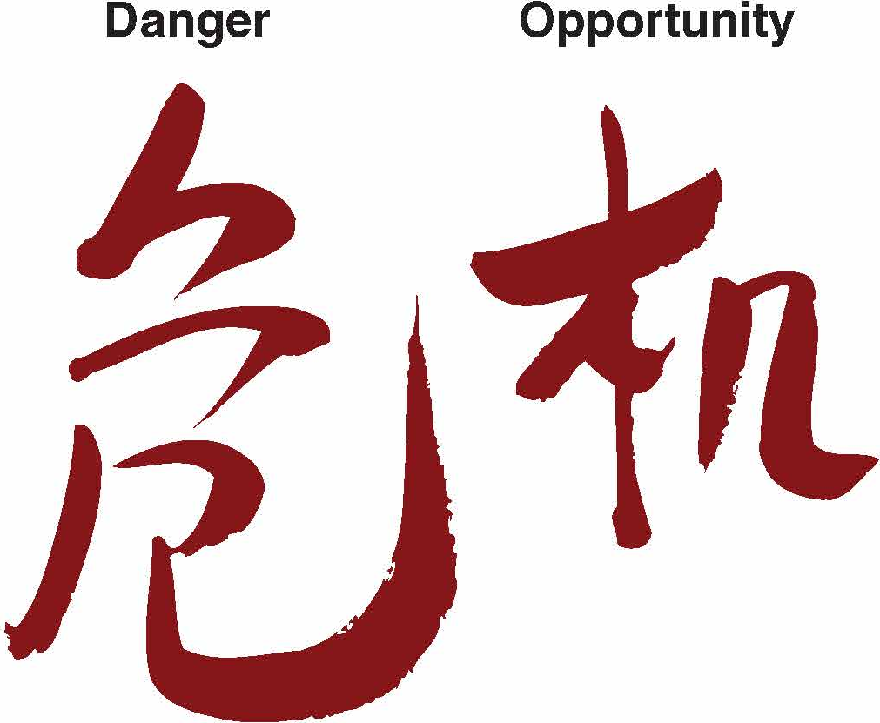
Danger and Opportunity
Chinese for “Crisis”

Slide 7
Orientations to Conflict
Lose–Lose
Assumes that conflict results in losses for everyone
Win–Lose
Assumes that one person wins at the expense of the other
Win–Win
Assumes that there are usually ways to resolve differences so that everyone gains

Slide 8
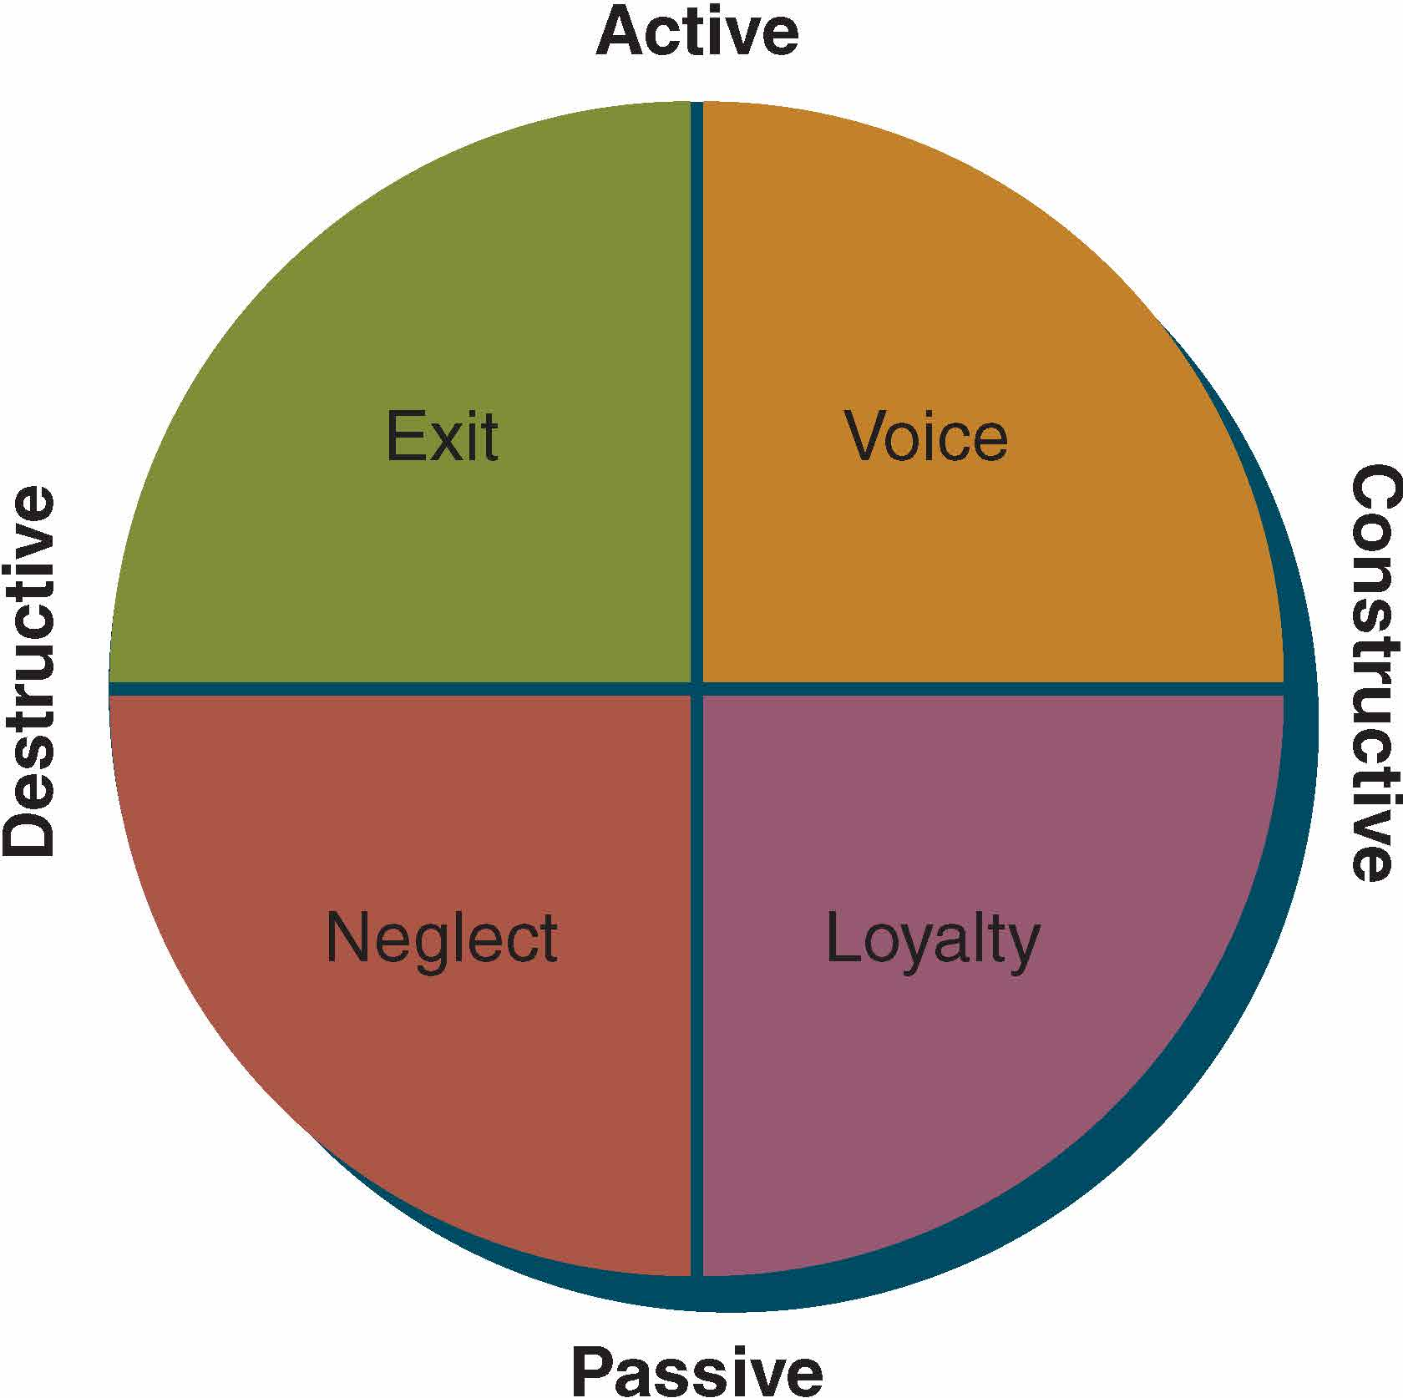
Responses to Conflict

Slide 9

Unproductive Conflict Communication
Disconfirmation of each other
Poor listening
Preoccupation with self
Cross-complaining
Hostile mind-reading

Slide 10

Unproductive Conflict Communication (cont’d)
Frequent interruptions
Kitchen-sinking
Counterproposals
Excessive meta-communication
Self-summarizing by both partners

Slide 11

Constructive Communication
Validation of each other
Sensitive listening
Dual perspective
Recognition of other’s concerns
Asking for clarification
Infrequent interruptions
Focus on specific issues
Compromises and contracts
Useful meta-communication
Summarizing the concerns

Slide 12
Conflict Management Skills
Attend to the relationship level of meaning
Communicate supportively
Listen mindfully
Take responsibility for your thoughts, feelings, and issues

Slide 13
Conflict Management Skills (cont’d)
Check perceptions
Look for points of agreement
Look for ways to preserve the other’s “face”
Imagine how you’ll feel in the future

Slide 14
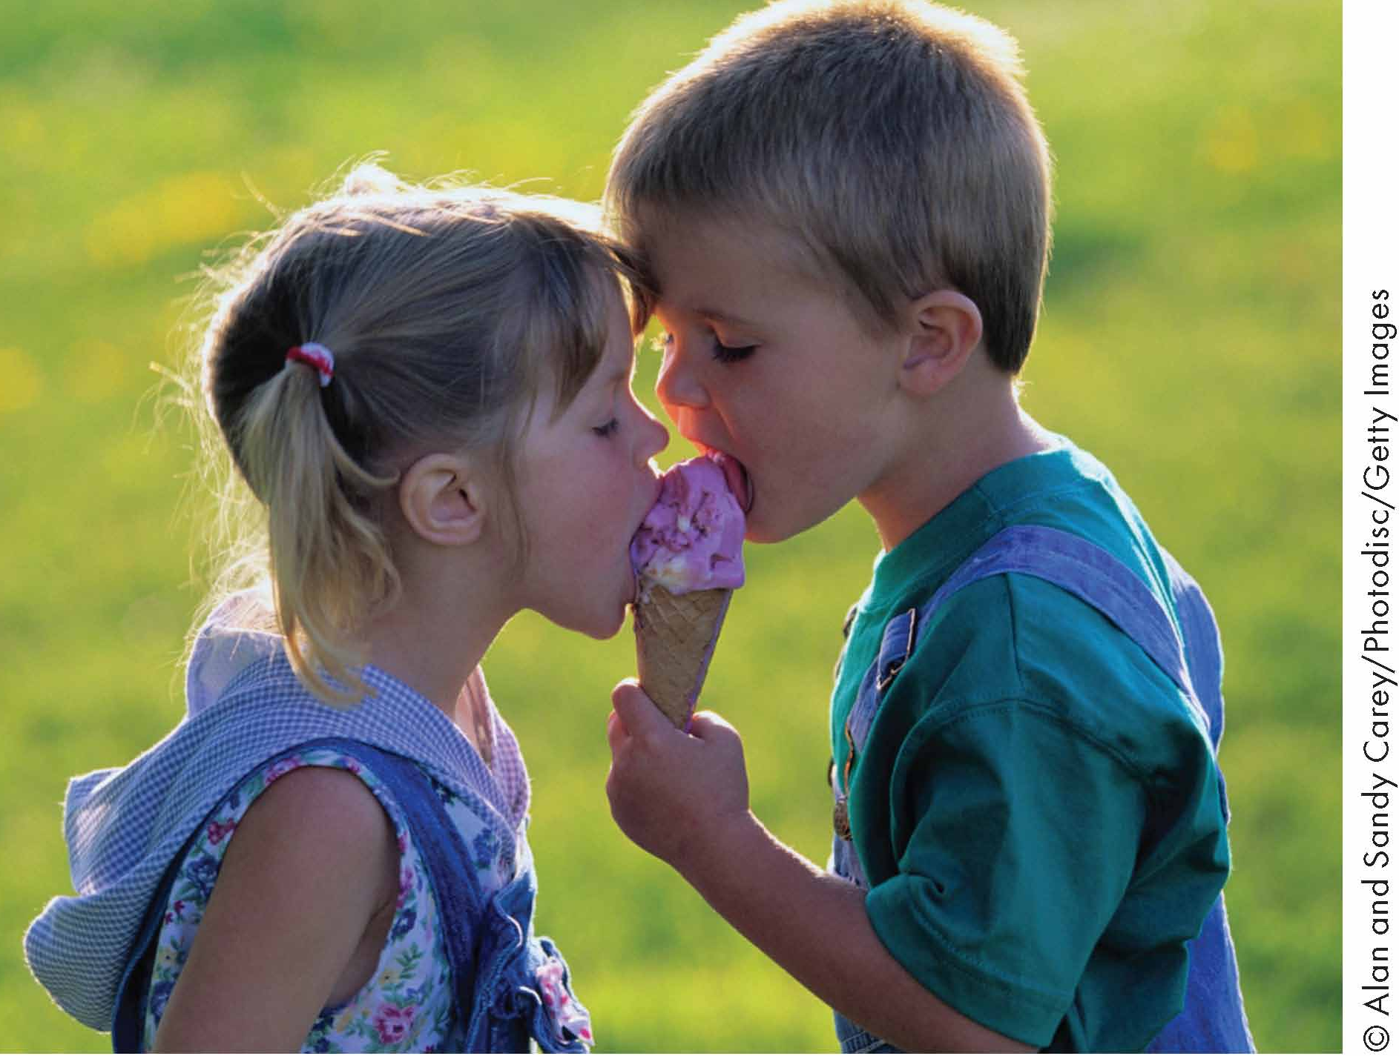
Win-Win Conflict Resolution
Express your needs
Solicit the needs of the other
Negotiate a solution
Follow up

Slide 15
Guidelines for Effective Communication During Conflict
Focus on the Overall Communication System
Time Conflict Purposefully
Aim for Win–Win Conflict
Honour Yourself, Your Partner, and the Relationship
Show Grace When Appropriate

Slide 16
Summary
Interpersonal Conflict
Effective Communication
Principles
Chapter 13
Conflict Management
Orientation
Constructive Conflict
Unproductive Conflict

